Slide 1
Educators & Non-suicidal Self-Injury(NSSI)
Dr. Laura Mueller
Licensed Educational Psychologist
Program Director, Alliant International University
October 2023

Slide 2
A little bit about me
11 adult children total- ages (24-34)
Assisstant Professor/Program Director at Alliant International University, CSOE PPS School Psychology
Doctoral Degree in Educational Psychology
School Psychologist for Poway Unified School District

Slide 3
Non-suicidal Self-Injury: Definition
Non‐suicidal self‐injury (NSSI) is the deliberate damage to one's body tissue in the absence of suicidal intent (NSSI; International Society for the Study of Self‐Injury, 2018). NSSI can include cutting or scratching the skin, although the range of behaviors is diverse (Swannell et al., 2014). Individuals commonly report engaging in NSSI as a means of regulating particularly intense or unwanted emotions (Taylor et al., 2018).
Quoted from: Modeling pathways to non‐suicidal self‐injury: The roles of perfectionism, negative affect, rumination, and attention control- Tonta, et.al

Slide 4
Self-Injury: Definitions
Self-injury defined: Favazza wrote a seminal definition of self-mutilation in his 1998 work, “The Coming Age of Self-Mutilation:”
“Self-Mutilation (SM) refers to the deliberate, direct destruction or alteration of body tissue without conscious suicidal intent.” (Favazza,1998, p. 260).
Many researchers further clarify this definition to exclude socially acceptable forms of SI such as ear piercing and tattooing (Walsh & Rosen, 1988) and SI which can accompany autism or other developmental disorders (Ross, et. al., 2009).
In my work, SI refers to these deliberately destructive acts resulting in tissue damage that are not intended as an act of suicide, are not widely socially acceptable, and are not due to intellectual disability, autism, or other developmental disorders.

Slide 5
DSM 5: Condition for further study
Proposed Criteria
In the last year, the individual has, on 5 or more days, engaged in intentional self-inflicted damage to the surface of his or her body of a sort likely to induce bleeding, bruising, or pain (e.g., cutting, burning, stabbing, hitting, excessive rubbing), with the expectation that the injury will lead to only minor or moderate physical harm (i.e., there is no suicidal intent).
Note: The absence of suicidal intent has either been stated by the individual or can be inferred by the individual’s repeated engagement in a behavior that the individual knows, or has learned, is not likely to result in death.
The individual engages in the self-injurious behavior with one or more of the following expectations:
To obtain relief from a negative feeling or cognitive state.
To resolve an interpersonal difficulty.
To induce a positive feeling state.
Note: The desired relief or response is experienced during or shortly after the self-injury, and the individual may display patterns of behavior suggesting a dependence on repeatedly engaging in it.

Slide 6
DSM 5 continued
The intentional self-injury is associated with at least one of the following:
Interpersonal difficulties or negative feelings or thoughts, such as depression, anxiety, tension, anger, generalized distress, or self-criticism, occurring in the period immediately prior to the self-injurious act.
Prior to engaging in the act, a period of preoccupation with the intended behavior that is difficult to control.
Thinking about self-injury that occurs frequently, even when it is not acted upon.

Slide 7
Self-Injury: Prevalence
/
Self-injury is a phenomenon that impacts up to 15% (reporting at least one incident) of today’s students, often beginning around the ages of 13 to 15, but sometimes starting as early as elementary school..
Most recent studies continue to point to a prevalence between 12 and 25% with occurrence within the past 4 years. 6-7% of adolescents and young adults report recent Self-Injury (within the past 6 months).
According to the 2015 study Nonsuicidal self-injury among a representative sample of US adolescents”, 1 in 4 girls and 1 in 10 boys will self-harm

Slide 8
Myths about self-injury From the Cornell Research Program on Self-Injury (Caicedo, Whitlock)
Self-Injury is a suicide attempt or a failed suicide attempt
Self-Injury is done to seek attention
Anyone who self-injures is part of the Goth or emo subgroups
Someone who self-injures can quit if they really want to stop
Someone who self-injures is a danger to others

Slide 9
Who?
Females somewhat more likely than males (gender gap may be narrower than assumed)
Studies indicate conflicting results in terms of ethnicity and culture (some show higher rates among Caucasians, some show higher rates among Asian populations. African Americans and Arab Americans show particularly low rates. A 2020 literature review revealed some elevated numbers for male African Americans)
Two studies found self-reported religious or spiritual orientations to be protective
Feelings of connectedness seem to be a protective factor
Adolescence itself appears to be the biggest risk factor
References:
Understanding Nonsuicidal Self Injury in Youth. Whitlock and Rodham (School Psychology Forum: Research in Practice Volume 7 Issue 4 Winter 2013);
Nonsuicidal Self-Injury Among African American and Hispanic Adolescents and Young Adults: a Systematic Review Danilo A. Rojas-Velasquez1 & Emily I. Pluhar2,3 & Paul A. Burns4 & E. Thomaseo Burton5,6 # Society for Prevention Research 2020

Slide 10
Risk Factors
Factors noted in research include:
Emotion regulation capacity
Childhood trauma
Family dynamics and changes
Parental Criticism
Deficits in Communication Skills
Negative cognition (including a negative bias in interpreting social feedback from others- from research on the brain)
LGBTQI+
Comorbidity with other mental health disorders, including ADHD and depressive and anxiety symptoms paired with poor sleep quality
Perfectionism
Rumination

Slide 11
Why?
Intrapersonal-negative
NSSI decreases or distracts from aversive thoughts or feelings
Intrapersonal-positive
NSSI generates desired feelings
Interpersonal-negative
NSSI facilitates avoidance of undesired social situations or communication
Interpersonal-positive
NSSI facilitates communication and help-seeking
Taken from Exploring Why Students Self-Injure: The Functions of Nonsuicidal Self-Injury. Darosh and Lloyd-Richardson (School Psychology Forum: Research in Practice Volume 7 Issue 4 Winter 2013)

Slide 12
Although it is argued that self-harm serves multiple functions simultaneously, the reasons most consistently endorsed in both clinical and theoretical literature relate to the avoidance and elimination of, or escape from, aversive internal experience. Preliminary empirical data provides support for a strong experiential avoidance component. To this end, engagement in self-harm behaviours can be conceptualised as a specific manifestation of a broader experientially avoidant coping function: a means of gaining control over an otherwise uncontrollable stress response .
From: Nielsen E, Sayal K, Townsend E (2016) Exploring the Relationship between Experiential Avoidance, Coping Functions and the Recency and Frequency of Self-Harm. PLoS ONE 11(7): e0159854. doi:10.1371/journal.pone.0159854

Slide 13
Precipitating Factors and Triggers for Self-Harm
From 48 different triggers identified by participants, six themes arose: (1) distressing emotions, (2) sense of isolation, (3) exposure to self-harm, (4) relationship difficulties, (5) social comparison, and (6) school/work difficulties. The theme of distressing emotions was described by all participants and appeared to be considered the primary trigger for urges to self-harm, along with a sense of isolation, with other themes becoming triggers by causing distressing emotions.
From: Hetrick SE, Subasinghe A, Anglin K, Hart L, Morgan A and Robinson J (2020) Understanding the Needs of Young People Who Engage in Self-Harm: A Qualitative Investigation

Slide 14
The Cornell research Program on Self-Injury and Recovery
www.selfinjury.bctr.cornell.edu
Parents and their children interviewed from 2010-2012- a total of 55 individuals
Statistics and conclusions in this report based on a small N of 10 parent-child units (ages 15-22)
Average age of onset 13.9 according to youths and 14.3 according to parents
Both parents and youth state disclosure at 15
Findings suggest that parents may be unaware of the depth and breadth of their youth’s use of self-injury

Slide 15
Cornell Research
67% of the parents reported their child had stopped self injuring, 36% of youth reported they had stopped self-injuring
Youth commonly identified self-injury as an immediate way to cope with and relieve emotional pain and stress
Parents talked more about immediate reasons
Parents reported shock and guilt when learning about their child’s self-injury- questioned themselves about why they hadn’t noticed earlier

Slide 16
Cornell Research, cont.
“Youth reported that it was easiest for them to discuss their self-injury with their parents when the parents expressed concern, tried not to judge, and showed respect, patience, and curiosity about their experiences: ‘They try to let me know that they’re there if I want to talk or they start a conversation with me or come downstairs and visit with me.”

Slide 17
Predictors of self-injury cessation among college students Whitlock, Prussien, and Pietrusza (2015)
Emotional regulation
Age/maturity play a big role
Finding NSSI to be a problem
Being open to therapy and viewing therapy positively
Positive connections- available, perceived, and made use of.

Slide 19
Developing School Policy on NSSI
Berger, Hasking, Reupert (2015)
It was found that educators continue to report a lack of information, resources, and policy
Recommendations mirror those on my website

Slide 20
How does AB 2246 tie in?
Language in the Model Youth Suicide Prevention Policy does not specifically mention NSSI
However, self-harm is included as a “high-risk” behavior for suicide on model protocols
AB 2246 gives school districts the opportunity to address NSSI with staff and:
Offer specific training on how to differentiate self-harm behaviors which put a student in a higher risk category vs. expression of ideation which students who are self-harming are unlikely to do.

Slide 21
Immediate and Ongoing intervention
A site or district protocol should be in place that determines which staff are responsible for each piece of intervention
Assess the need for medical attention
Complete a suicide risk assessment*
Notify parents and document
Consider the contagion factor
Create a communication plan between outside providers, parents, and the school site
Create a plan for the for the student to follow during the day
*a 2020 study (Pallini, S., Terrinoni, A., Iannello, S., Cerutti, R., Ferrara, M., Fantini, F. and Laghi, F. (2020), Attachment‐Related Representations and Suicidal Ideations in Nonsuicidal Self‐Injury Adolescents with and without Suicide Attempts: A Pilot Study. Suicide Life Threat Behav, 50: 909-920. doi:10.1111/sltb.12633) underscores the higher risk for suicide attempts and completions for individuals who self injure.

Slide 22
Some important points
Trust your instincts, don’t ignore red flags
Do not see homogenous groups of self-injurers
Always refer out, but a school psychologist or counselor may provide treatment and intervention at school (focused on coping strategies, anxiety management, could use CBT manual-based therapy)
Set calendar reminders to check in with students and families who you are not seeing regularly.

Slide 23
RESOURCE: EducatorsAndSelfInjury.com
Developed as a resource for all educators: especially school nurses, school psychologists, school counselors, and teachers
01
Includes many resources including a protocol for immediate response to self-injury
02
The website is in a brief and simple format and therefore serves as a useful tool for educators needing important information regarding response and intervention to self-injury in a limited amount of time
03

Slide 24
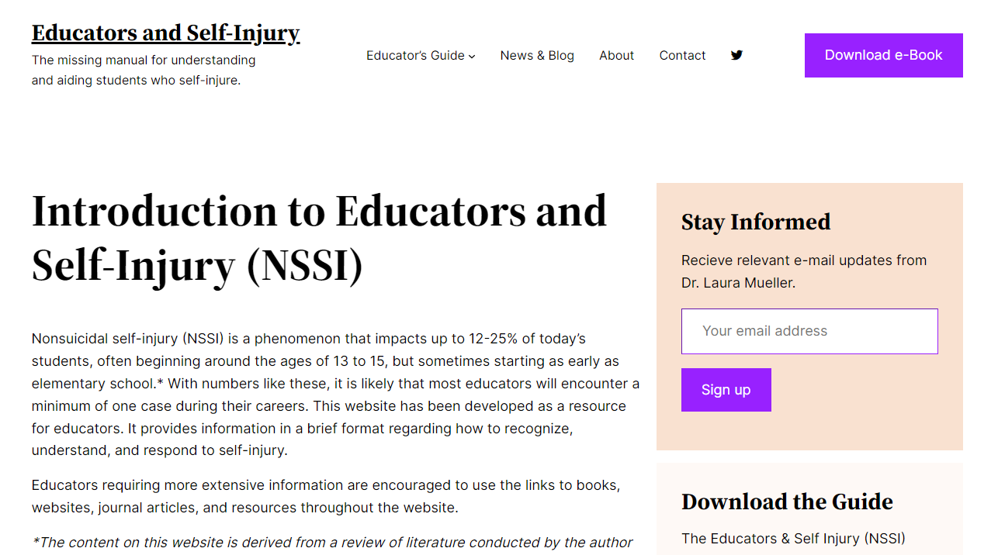
EducatorsAndSelfInjury.com

Slide 25
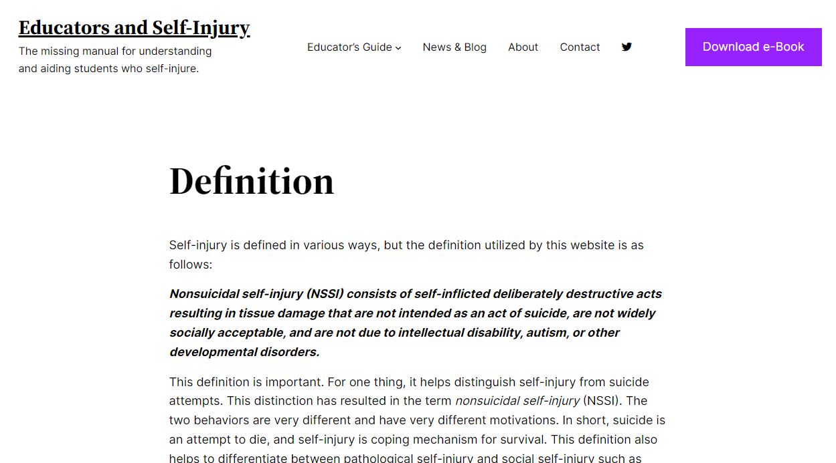

Slide 26
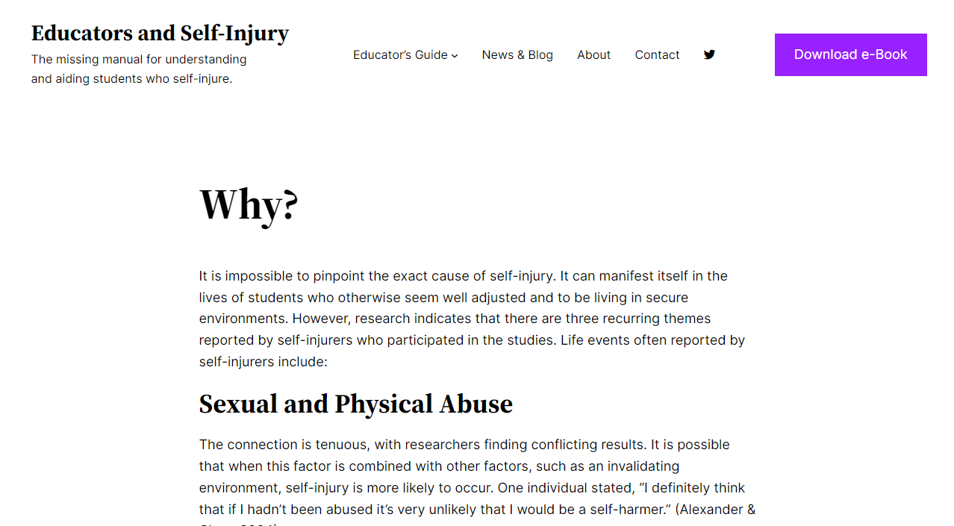

Slide 28
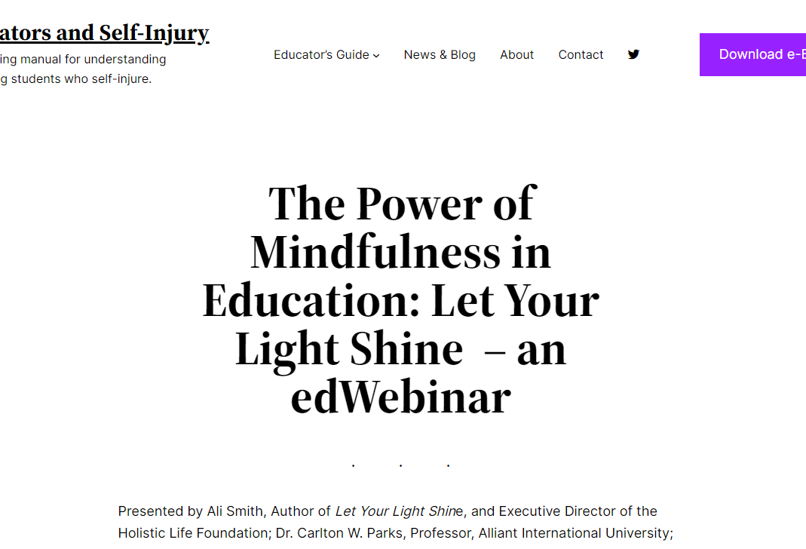

Slide 29
Stress, depression, and anxiety in teens

Slide 30
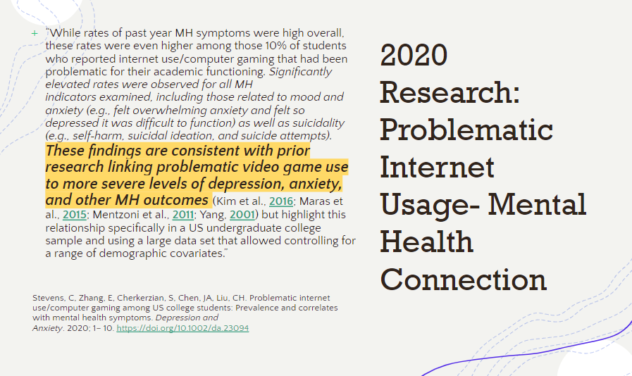

Slide 31
Contributors to stress and anxiety
High emphasis on academic achievement (AP classes, 4.0+ GPAS, high test scores)
High emphasis on involvement in extracurricular activities and to excel in those areas (sports, dance, theater, music lessons)
Over-availability and abundance of screens: Smart Phones, TVs, Computers, Tablets

Slide 32
Contributors to stress and anxiety
TV, Netflix, HULU, Facebook, Snapchat, Instragram
Not enough face to face time with adults and therefore: lack of training and role-modeling in two key areas- social interaction and emotional regulation/coping (adult to child ratio too high from infanthood onward).
Please consider watching Dr. Bruce Perry: https://www.youtube.com/watch?v=vkJwFRAwDNE and a variety of other videos you can find by googling his name.
http://childtrauma.org/

Slide 33
What helps?

Slide 34
It would be crucial to support the most vulnerable adolescents who engage in NSSI in order to prevent the increase in frequency of the behavior over time. This could be done in two ways.
First, through intervention programs to reduce NSSI and behaviors.
Second, promoting an individualized support network between schools and community services could be helpful in improving the intake and preventing the behavior from becoming chronic, leading to further serious consequences. The school psychologist, along with the school personnel, could have a key role in these actions.
From: The development of Non-Suicidal Self-Injury (NSSI) during adolescence: A systematic review and Bayesian meta-analysis
Lisa De Luca, Massimiliano Pastore, Benedetta Emanuela Palladino,, Birgit Reime, Patrick Warth, Ersilia Menesini

Slide 35
Treatment plans that work
Combined Individual and Family Treatment
Therapeutic Alliance (more important than theoretical orientation)
Individualized Tailoring of Treatment (takes into account the variation in risk and protective factors for youth and families)
Skills Training and Safety Planning- DBT-based (most implementable in the school environment)
Lethal Means Restriction Counseling
Working with youth to build a commitment to safety processes (Safety contracts have not been shown to be effective)
From: Practitioner Review: Common elements in treatments for youth suicide attempts and self-harm – a practitioner review based on review of treatment elements associated with intervention benefits Jocelyn I. Meza,1,2 Lucas Zullo,1 Sylvanna M. Vargas,1,2 Dennis Ougrin,3 and Joan R. Asarnow1

Slide 36
What young people reported
1) The idiosyncratic nature of self-help- “Different things work for different people at different times/days and in different situations…”
2) The importance of distraction- “Need a toolbox of resources to draw on when you need it at different times… A Comfort box… to put personal things in that make you feel good.”
3) Connectedness- “For me it is about feeling real… and like I am not by myself”… “We would talk about it for a little while and try to rationalize it.” “So if you can sit with someone… just sit and be safe.” (Lack of connectedness was also found to be a salient factor in a study related to COVID-19 and NSSI)
4) Change in the environment- “Was helpful to be places where there was structure and I couldn’t leave.” “if I exercise I am in a much better head space.”
5) Mimicking strategies – Young people largely reported that these were unhelpful- “It doesn’t give you the same feeling but is ok when out.” “…don’t really communicate how valid my distress is.” “Actually made me self-harm in some ways… I kept doing it worse and worse.”
From: Hetrick SE, Subasinghe A, Anglin K, Hart L, Morgan A and Robinson J (2020) Understanding the Needs of Young People Who Engage in Self-Harm: A Qualitative Investigation

Slide 37
What helps?
As far as YOU are able, make sure there is DOWNTIME in kid’s schedules
Help kids learn to name, accept, and process their emotions: Mental Health providers should be utilizing CBT (or DBT) to address negative thinking styles.
Help student identify their triggers.
Help kids learn to identify adaptive coping strategies that are meaningful to them (walking, singing, listening to music, talking with friends, swimming, swinging… )
Help students identify the trusted adults and friends in their lives.
Don’t be part of overloading a student with inappropriate expectations: Fight the notion of overachievement at any cost. (RACE TO NOWHERE- google it!)

Slide 38
What helps?
Encourage kids to follow their own goals, dreams, and ideas (don’t cave to “the man”)
Promote the acceptance and validity of all jobs- trash collectors, beauticians, cashiers, ride operators, and gardeners are all VALID, needed, and meaningful
Promote human relationships and time with people as the most valuable *thing*
Promote responsible screen time- any time spent with a screen is time NOT growing socially and emotionally
Learning Self-Compassion
Mindfulness: http://thehawnfoundation.org/mindup/
Meditation: Headspace https://www.headspace.com/educators

Slide 39
Other resources/websites
www.sioutreach.org
www.icsesgroup.org
http://www.selfinjury.bctr.cornell.edu/
http://www.self-injury.org.au
http://www.selfinjury.bctr.cornell.edu/documents/schools.pdf
www.Selfinjury.com/referrals/sites
www.Crisistextline.org/selfharm

Slide 40
Questions?

Slide 41
References Include
Understanding Nonsuicidal Self Injury in Youth. Whitlock and Rodham (School Psychology Forum: Research in Practice Volume 7 Issue 4 Winter 2013)
Jiao T, Guo S, Zhang Y, Li Y, Xie X, Ma Y, Chen R, Yu Y and Tang J (2022) Associations of depressive and anxiety symptoms with non-suicidal self-injury and suicidal attempt among Chinese adolescents: The mediation role of sleep quality. Front. Psychiatry 13:1018525. doi: 10.3389/fpsyt.2022.1018525
Gyori D and Balazs J (2021) Nonsuicidal Self-Injury and Perfectionism: A Systematic Review. Front. Psychiatry 12:691147. doi: 10.3389/fpsyt.2021.691147
Tonta, K. E., Boyes, M., Howell, J., McEvoy, P., Johnson, A., & Hasking, P. (2022). Modeling pathways to non‐suicidal self‐injury: The roles of perfectionism, negative affect, rumination, and attention control. Journal of Clinical Psychology, 78, 1463–1477. https://doi.org/10.1002/jclp.23315
Nielsen E, Sayal K, Townsend E (2016) Exploring the Relationship between Experiential Avoidance, Coping Functions and the Recency and Frequency of Self-Harm. PLoS ONE 11(7): e0159854. doi:10.1371/journal.pone.0159854
Brain-based Classification of Negative Social Bias in Adolescents With Nonsuicidal Selfinjury: Findings From Simulated Online Social Interaction Irene Perini a, ⁎, Per A. Gustafsson a,b , J. Paul Hamilton a , R. Kämpe a , Leah M. Mayo a , Markus Heilig a,c,1 , Maria Zetterqvist a,b,1
The Four-Function Model of Nonsuicidal Self-Injury: Key Directions for Future Research Kate H. Bentley1 , Matthew K. Nock2 , and David H. Barlow1

Slide 42
References continued
Practitioner Review: Common elements in treatments for youth suicide attempts and self-harm – a practitioner review based on review of treatment elements associated with intervention benefits Jocelyn I. Meza,1,2 Lucas Zullo,1 Sylvanna M. Vargas,1,2 Dennis Ougrin,3 and Joan R. Asarnow1
The development of Non-Suicidal Self-Injury (NSSI) during adolescence: A systematic review and Bayesian meta-analysis
Lisa De Luca, Massimiliano Pastore, Benedetta Emanuela Palladino,, Birgit Reime, Patrick Warth, Ersilia Menesini
Risk factors of suicidal spectrum behaviors in adults and adolescents with attention-defcit / hyperactivity disorder – a systematic review. Amalie Austgulen1†, Nanna Karen Gilberg Skram2†, Jan Haavik1,3 and Astri J. Lundervold2*
Hetrick SE, Subasinghe A, Anglin K, Hart L, Morgan A and Robinson J (2020) Understanding the Needs of Young People Who Engage in Self-Harm: A Qualitative Investigation
Mental Health, Suicidality, and Connectedness Among High School Students During the COVID-19 Pandemic — Adolescent Behaviors and Experiences Survey, United States, January–June 2021 Sherry Everett Jones, PhD1; Kathleen A. Ethier, PhD1; Marci Hertz, MS1; Sarah DeGue, PhD2; Vi Donna Le, PhD2; Jemekia Thornton, MPA1; Connie Lim, MPA1; Patricia J Dittus, PhD1; Sindhura Geda, MS3
A list of further references can be found at this link: https://educatorsandselfinjury.com/references/

